Slide 1
William Stallings
Computer Organization and Architecture
8th Edition
Chapter 7
Input/Output

Slide 2
Input/Output Problems
Wide variety of peripherals
  Delivering different amounts of data
  At different speeds
  In different formats
All slower than CPU and RAM
Need I/O modules

Slide 3
Input/Output Module
Interface to CPU and Memory
Interface to one or more peripherals

Slide 4
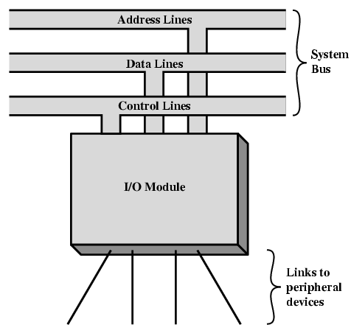
Generic Model of I/O Module

Slide 5
External Devices
Human readable
  Screen, printer, keyboard
Machine readable
  Monitoring and control
Communication
  Modem
  Network Interface Card (NIC)

Slide 6
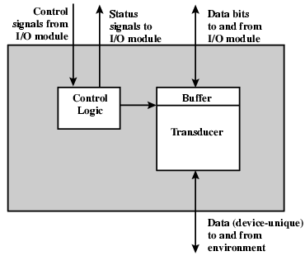
External Device Block Diagram

Slide 7
I/O Module Function
Control & Timing
CPU Communication
Device Communication
Data Buffering
Error Detection

Slide 8
I/O Steps
CPU checks I/O module device status
I/O module returns status
If ready, CPU requests data transfer
I/O module gets data from device
I/O module transfers data to CPU
Variations for output, DMA, etc.

Slide 9
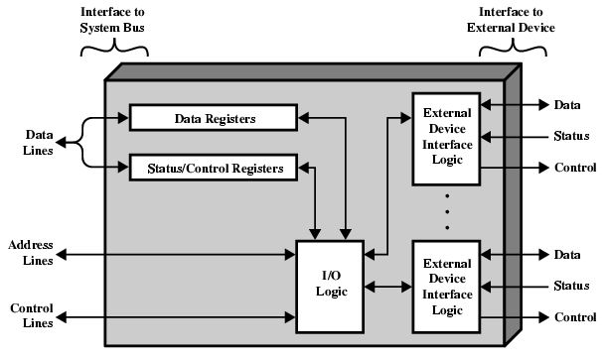
I/O Module Diagram

Slide 10
I/O Module Decisions
Hide or reveal device properties to CPU
Support multiple or single device
Control device functions or leave for CPU
Also O/S decisions
  e.g. Unix treats everything it can as a file

Slide 11
Input Output Techniques
Programmed
Interrupt driven
Direct Memory Access (DMA)

Slide 12
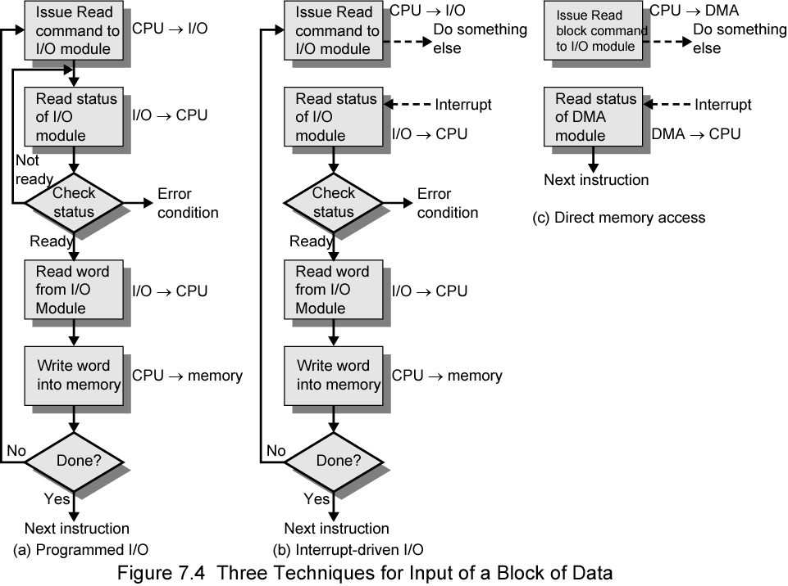
Three Techniques for
Input of a Block of Data

Slide 13
Programmed I/O
CPU has direct control over I/O
  Sensing status
  Read/write commands
  Transferring data
CPU waits for I/O module to complete operation
Wastes CPU time

Slide 14
Programmed I/O - detail
CPU requests I/O operation
I/O module performs operation
I/O module sets status bits
CPU checks status bits periodically
I/O module does not inform CPU directly
I/O module does not interrupt CPU
CPU may wait or come back later

Slide 15
I/O Commands
CPU issues address
  Identifies module (& device if >1 per module)
CPU issues command
  Control - telling module what to do
    e.g. spin up disk
  Test - check status
    e.g. power? Error?
  Read/Write
    Module transfers data via buffer from/to device

Slide 16
Addressing I/O Devices
Under programmed I/O data transfer is very like memory access (CPU viewpoint)
Each device given unique identifier
CPU commands contain identifier (address)

Slide 17
I/O Mapping
Memory mapped I/O
  Devices and memory share an address space
  I/O looks just like memory read/write
  No special commands for I/O
    Large selection of memory access commands available
Isolated I/O
  Separate address spaces
  Need I/O or memory select lines
  Special commands for I/O
    Limited set

Slide 18
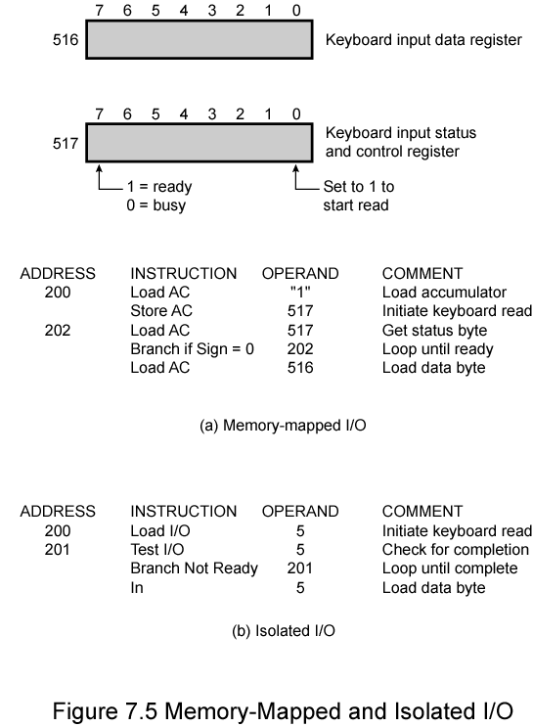
Memory Mapped and Isolated I/O

Slide 19
Interrupt Driven I/O
Overcomes CPU waiting
No repeated CPU checking of device
I/O module interrupts when ready

Slide 20
Interrupt Driven I/O
Basic Operation
CPU issues read command
I/O module gets data from peripheral whilst CPU does other work
I/O module interrupts CPU
CPU requests data
I/O module transfers data

Slide 21
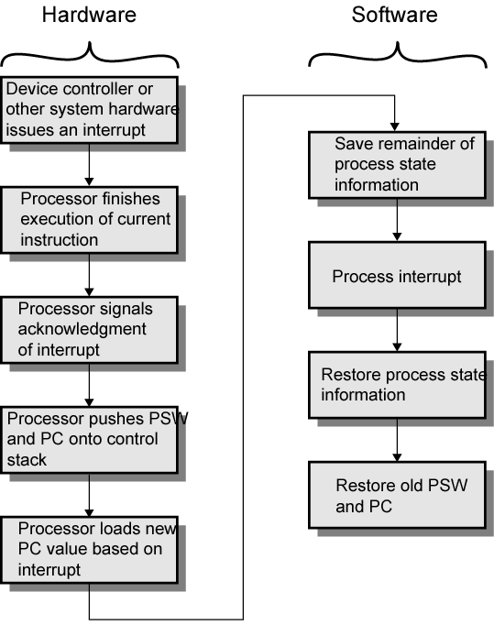
Simple Interrupt
Processing

Slide 22
CPU Viewpoint
Issue read command
Do other work
Check for interrupt at end of each instruction cycle
If interrupted:-
  Save context (registers)
  Process interrupt
    Fetch data & store
See Operating Systems notes

Slide 23
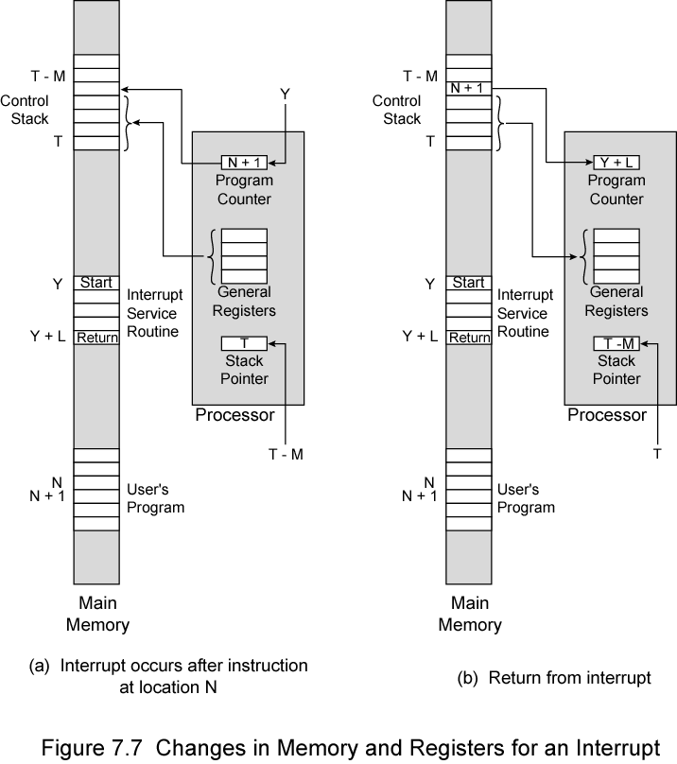
Changes in Memory and Registers for an Interrupt

Slide 24
Design Issues
How do you identify the module issuing the interrupt?
How do you deal with multiple interrupts?
  i.e. an interrupt handler being interrupted

Slide 25
Identifying Interrupting Module (1)
Different line for each module
  PC
  Limits number of devices
Software poll
  CPU asks each module in turn
  Slow

Slide 26
Identifying Interrupting Module (2)
Daisy Chain or Hardware poll
  Interrupt Acknowledge sent down a chain
  Module responsible places vector on bus
  CPU uses vector to identify handler routine
Bus Master
  Module must claim the bus before it can raise interrupt
  e.g. PCI & SCSI

Slide 27
Multiple Interrupts
Each interrupt line has a priority
Higher priority lines can interrupt lower priority lines
If bus mastering only current master can interrupt

Slide 28
Example - PC Bus
80x86 has one interrupt line
8086 based systems use one 8259A interrupt controller
8259A has 8 interrupt lines

Slide 29
Sequence of Events
8259A accepts interrupts
8259A determines priority
8259A signals 8086 (raises INTR line)
CPU Acknowledges
8259A puts correct vector on data bus
CPU processes interrupt

Slide 30
ISA Bus Interrupt System
ISA bus chains two 8259As together
Link is via interrupt 2
Gives 15 lines
  16 lines less one for link
IRQ 9 is used to re-route anything trying to use IRQ 2
  Backwards compatibility
Incorporated in chip set

Slide 31
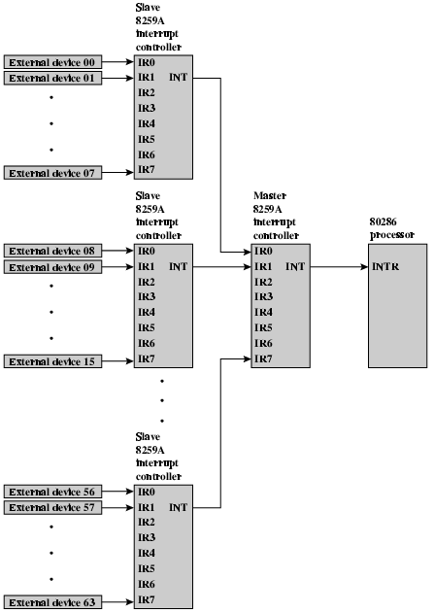
82C59A Interrupt
Controller

Slide 32
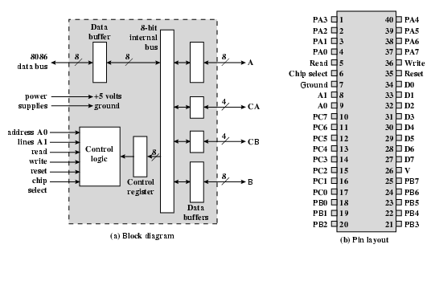
Intel 82C55A
Programmable Peripheral Interface

Slide 33
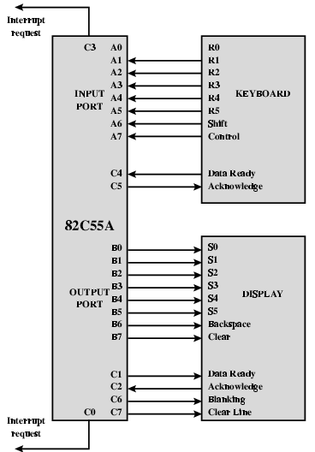
Keyboard/Display Interfaces to 82C55A

Slide 34
Direct Memory Access
Interrupt driven and programmed I/O require active CPU intervention
  Transfer rate is limited
  CPU is tied up
DMA is the answer

Slide 35
DMA Function
Additional Module (hardware) on bus
DMA controller takes over from CPU for I/O

Slide 36
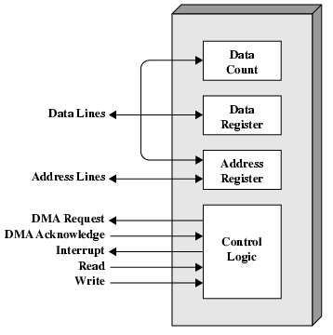
Typical DMA Module Diagram

Slide 37
DMA Operation
CPU tells DMA controller:-
  Read/Write
  Device address
  Starting address of memory block for data
  Amount of data to be transferred
CPU carries on with other work
DMA controller deals with transfer
DMA controller sends interrupt when finished

Slide 38
DMA Transfer
Cycle Stealing
DMA controller takes over bus for a cycle
Transfer of one word of data
Not an interrupt
  CPU does not switch context
CPU suspended just before it accesses bus
  i.e. before an operand or data fetch or a data write
Slows down CPU but not as much as CPU doing transfer

Slide 39
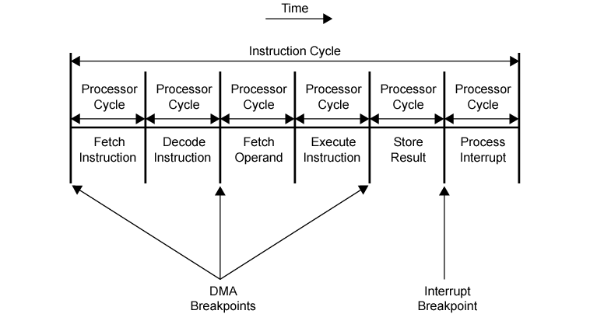
DMA and Interrupt Breakpoints During an Instruction Cycle

Slide 40
Aside
What effect does caching memory have on DMA?
What about on board cache?
Hint: how much are the system buses available?

Slide 41
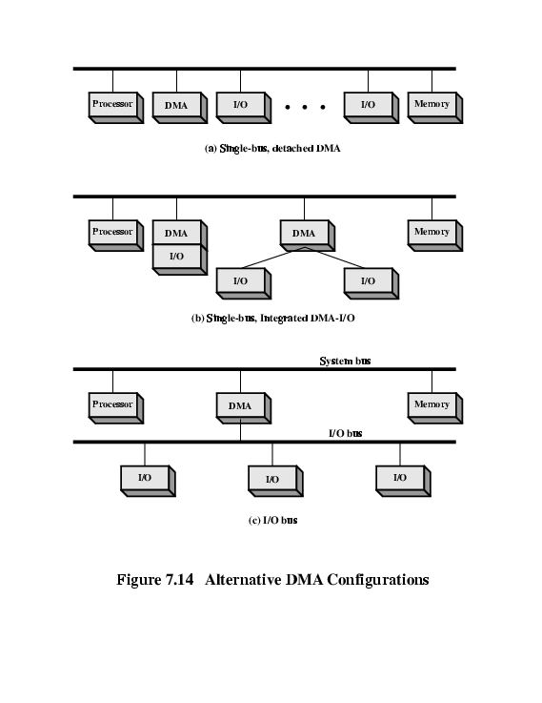
DMA Configurations (1)
Single Bus, Detached DMA controller
Each transfer uses bus twice
  I/O to DMA then DMA to memory
CPU is suspended twice

Slide 42
DMA Configurations (2)
Single Bus, Integrated DMA controller
Controller may support >1 device
Each transfer uses bus once
  DMA to memory
CPU is suspended once

Slide 43
DMA Configurations (3)
Separate I/O Bus
Bus supports all DMA enabled devices
Each transfer uses bus once
  DMA to memory
CPU is suspended once

Slide 44
Intel 8237A DMA Controller
Interfaces to 80x86 family and DRAM
When DMA module needs buses it sends HOLD signal to processor
CPU responds HLDA (hold acknowledge)
  DMA module can use buses
E.g. transfer data from memory to disk
  Device requests service of DMA by pulling DREQ (DMA request) high
  DMA puts high on HRQ (hold request),
  CPU finishes present bus cycle (not necessarily present instruction) and puts high on HDLA (hold acknowledge). HOLD remains active for duration of DMA
  DMA activates DACK (DMA acknowledge), telling device to start transfer
  DMA starts transfer by putting address of first byte on address bus and activating MEMR; it then activates IOW to write to peripheral. DMA decrements counter and increments address pointer. Repeat until count reaches zero
  DMA deactivates HRQ, giving bus back to CPU

Slide 45
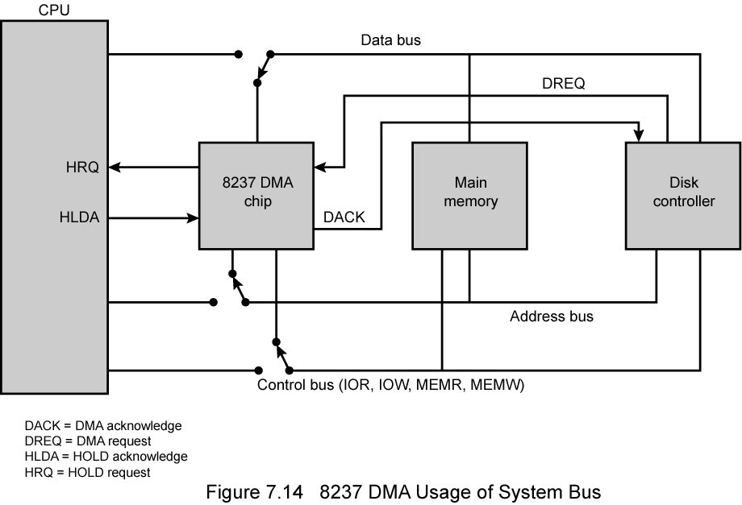
8237 DMA Usage of Systems Bus

Slide 46
Fly-By
While DMA using buses processor idle
Processor using bus, DMA idle
  Known as fly-by DMA controller
Data does not pass through and is not stored in DMA chip
  DMA only between I/O port and memory
  Not between two I/O ports or two memory locations
Can do memory to memory via register
8237 contains four DMA channels
  Programmed independently
  Any one active
  Numbered 0, 1, 2, and 3

Slide 47
I/O Channels
I/O devices getting more sophisticated
e.g. 3D graphics cards
CPU instructs I/O controller to do transfer
I/O controller does entire transfer
Improves speed
  Takes load off CPU
  Dedicated processor is faster

Slide 48
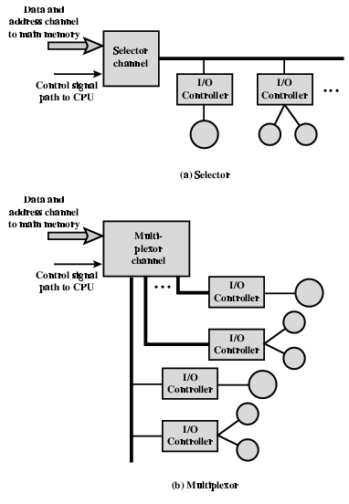
I/O Channel Architecture

Slide 49
Interfacing
Connecting devices together
Bit of wire?
Dedicated processor/memory/buses?
E.g. FireWire, InfiniBand

Slide 50
IEEE 1394 FireWire
High performance serial bus
Fast
Low cost
Easy to implement
Also being used in digital cameras, VCRs and TV

Slide 51
FireWire Configuration
Daisy chain
Up to 63 devices on single port
  Really 64 of which one is the interface itself
Up to 1022 buses can be connected with bridges
Automatic configuration
No bus terminators
May be tree structure

Slide 52
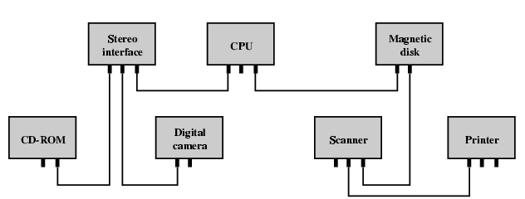
Simple FireWire Configuration

Slide 53
FireWire 3 Layer Stack
Physical
  Transmission medium, electrical and signaling characteristics
Link
  Transmission of data in packets
Transaction
  Request-response protocol

Slide 54
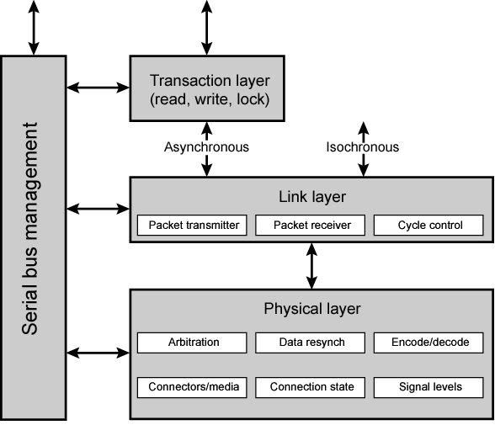
FireWire Protocol Stack

Slide 55
FireWire - Physical Layer
Data rates from 25 to 400Mbps
Two forms of arbitration
  Based on tree structure
  Root acts as arbiter
  First come first served
  Natural priority controls simultaneous requests
    i.e. who is nearest to root
  Fair arbitration
  Urgent arbitration

Slide 56
FireWire - Link Layer
Two transmission types
  Asynchronous
    Variable amount of data and several bytes of transaction data transferred as a packet
    To explicit address
    Acknowledgement returned
  Isochronous
    Variable amount of data in sequence of fixed size packets at regular intervals
    Simplified addressing
    No acknowledgement

Slide 57
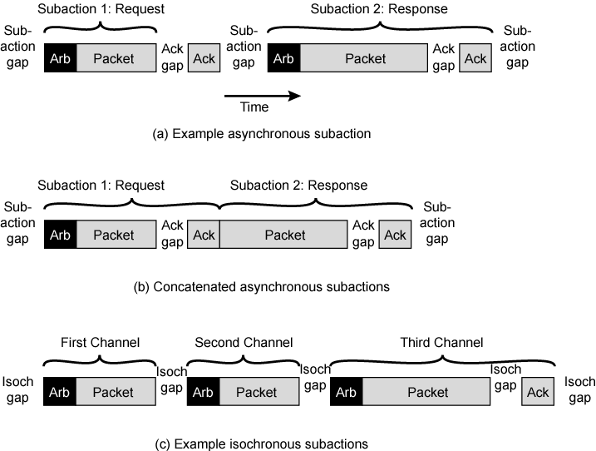
FireWire Subactions

Slide 58
InfiniBand
I/O specification aimed at high end servers
  Merger of Future I/O (Cisco, HP, Compaq, IBM) and Next Generation I/O (Intel)
Version 1 released early 2001
Architecture and spec. for data flow between processor and intelligent I/O devices
Intended to replace PCI in servers
Increased capacity, expandability, flexibility

Slide 59
InfiniBand Architecture
Remote storage, networking and connection between servers
Attach servers, remote storage, network devices to central fabric of switches and links
Greater server density
Scalable data centre
Independent nodes added as required
I/O distance from server up to
  17m using copper
  300m multimode fibre optic
  10km single mode fibre
Up to 30Gbps

Slide 60
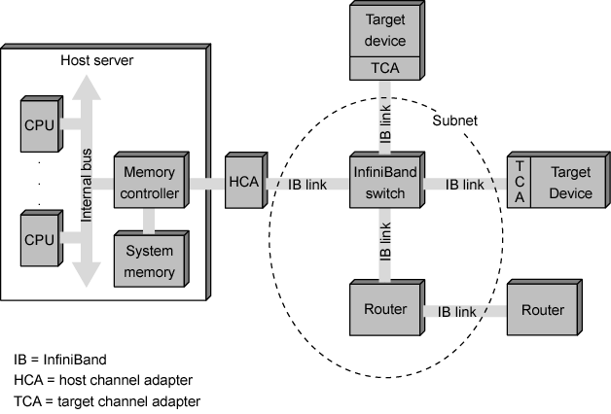
InfiniBand Switch Fabric

Slide 61
InfiniBand Operation
16 logical channels (virtual lanes) per physical link
One lane for management, rest for data
Data in stream of packets
Virtual lane dedicated temporarily to end to end transfer
Switch maps traffic from incoming to outgoing lane

Slide 62
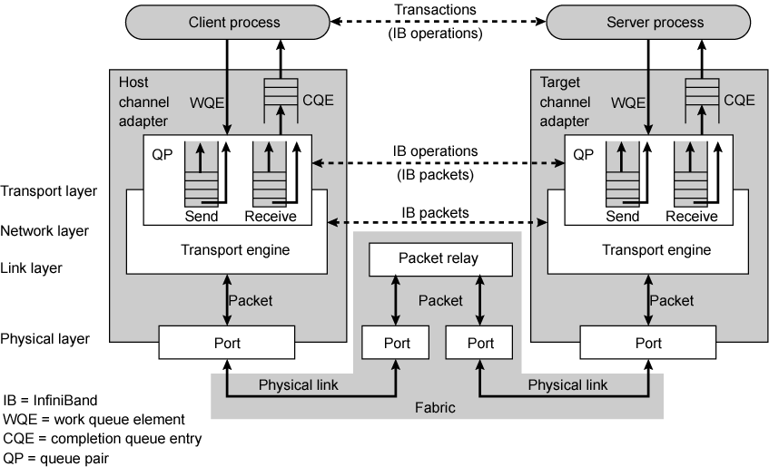
InfiniBand Protocol Stack

Slide 63
Foreground Reading
Check out Universal Serial Bus (USB)
Compare with other communication standards e.g. Ethernet

